Slide 2
We understand that you have many things pulling at your time. And, you desire to focus on what you do best.
We can help.
Our Turn-key Target Marketing Program can help you bring the specific customers that you want with little effort on your part.
When it comes to business communications services, we've got it covered.
We can provide virtually any product or service imaginable to communicate with your clients, employees, stockholders, or vendors
.
Also we believe promoting is an attitude.. and thus we let our work speak out for itself.

Slide 3
Mission Statement
Exceeding client expectations by providing the highest-quality
product / service possible in a timely manner.
We create long-lasting, prosperous relationships with our client
partners in order to help them reach their goals and objectives.
Our Target:
High quality is our mission.
Client satisfaction is our priority.
Providing successful solutions is our goal.
Creativity is our attitude.

Slide 7
Events Management

Slide 8
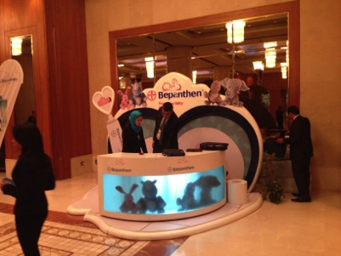
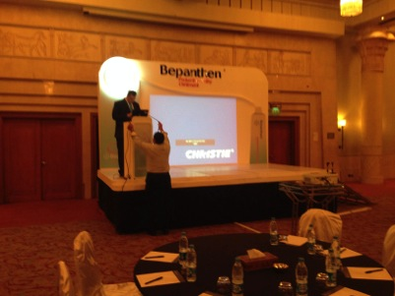
Bayer - Bepanthen Event
Booth
Stage & Backdrop

Slide 9
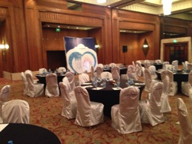
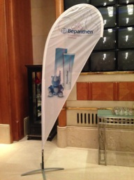
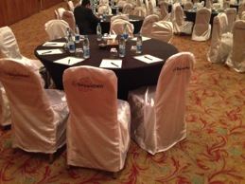
Bayer - Bepanthen Event
Meeting Room Branding
Flags
Chair covers, Notebooks & Pens

Slide 10
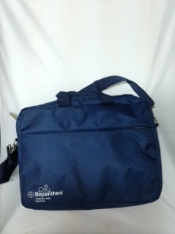
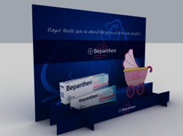
Bayer - Bepanthen Event
3D Invitation
Conference Bags

Slide 11
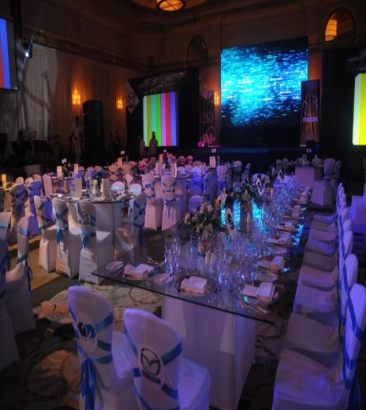
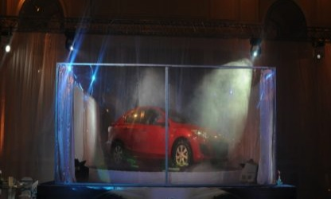
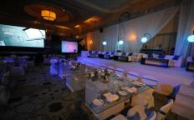
Mazda Launch – Four Seasons

Slide 12
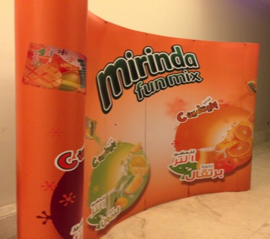
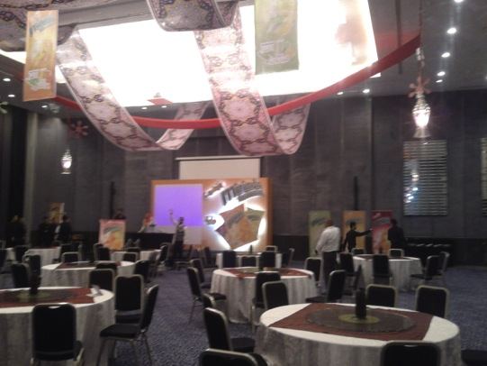
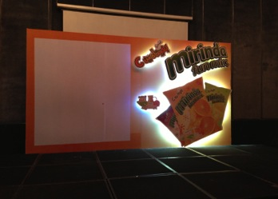
Mirinda Fun Mix Event

Slide 13
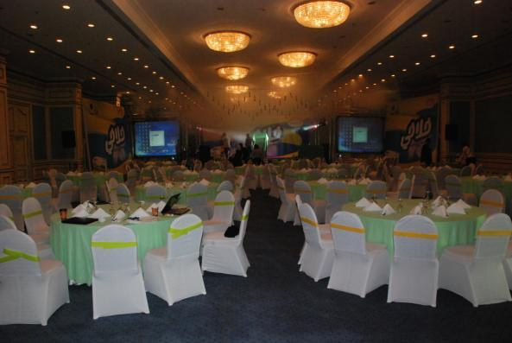
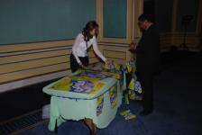
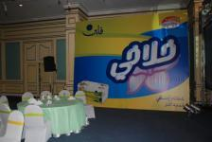
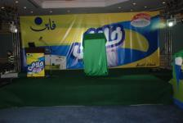
Fluffy launch Events

Slide 14
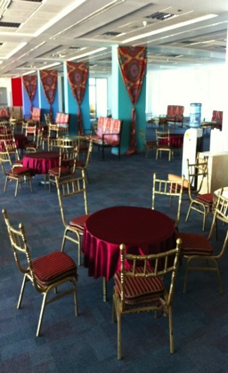
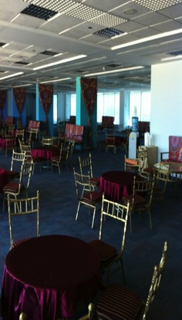
Ramadan Iftar Event

Slide 15
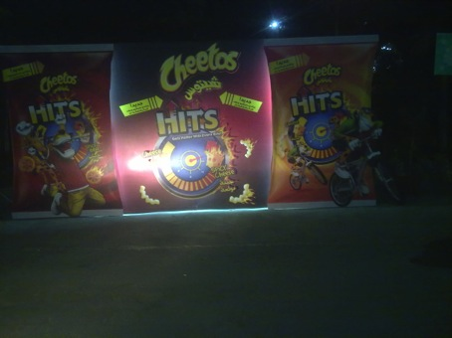
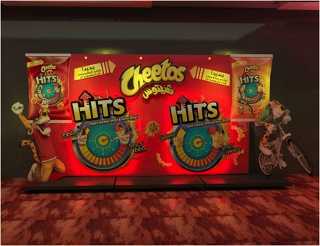
Cheetos Event- Display
Actual
Design

Slide 16
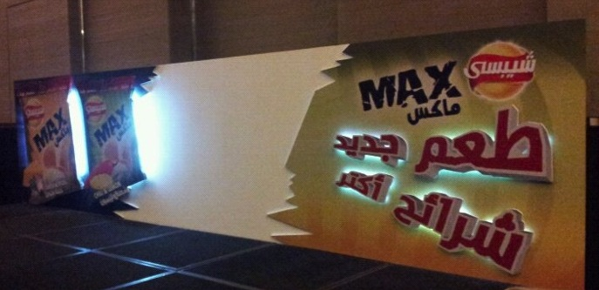
Chepsi Event

Slide 17
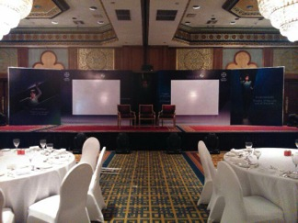
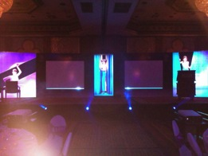
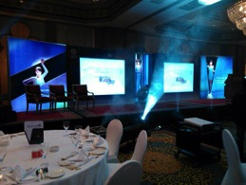
Bayer - Visanne Event
Stage & Backdrop with moving mechanism

Slide 18
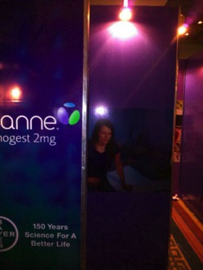
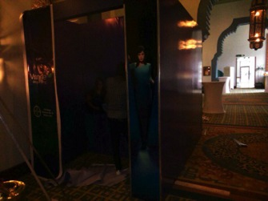
Bayer - Visanne Event
Entrance Tunnel

Slide 19
In-store Events

Slide 20
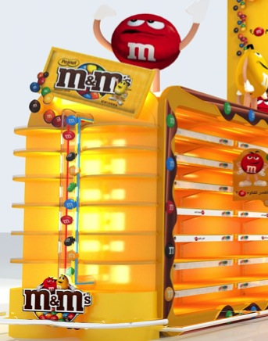
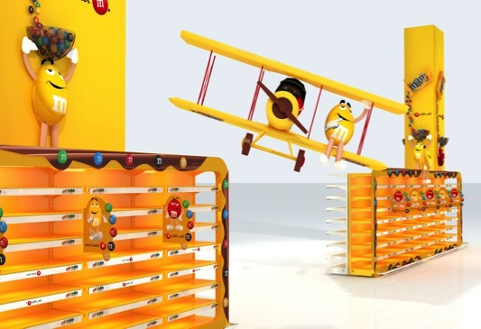
M&m’s carfrour Cairo Festival City- Design

Slide 21
M&m’s carrfour Cairo Festival City- Actual

Slide 22
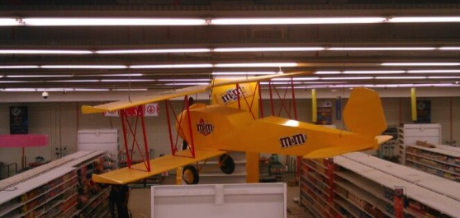
M&m’s carrfour Cairo Festival City- Actual

Slide 23
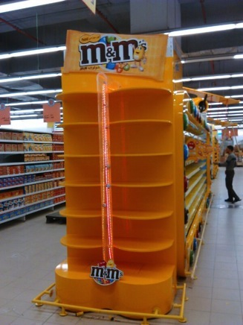
M&m’s carrfour Cairo Festival City- Actual

Slide 24
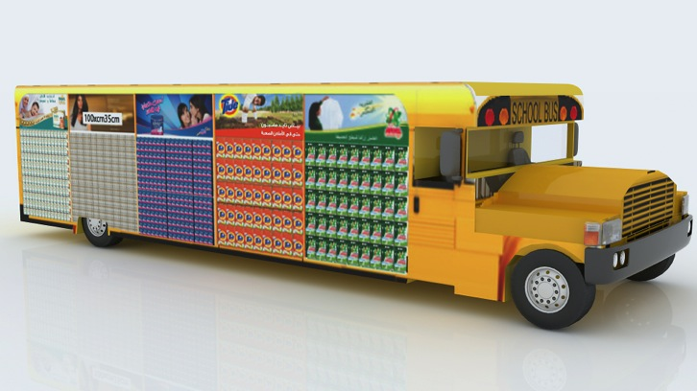
Hyper One Back to School Event- Design

Slide 25
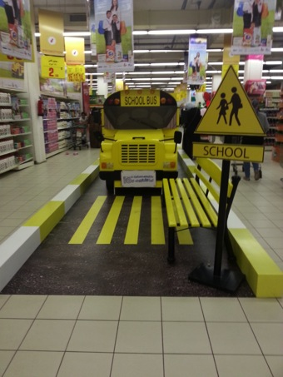
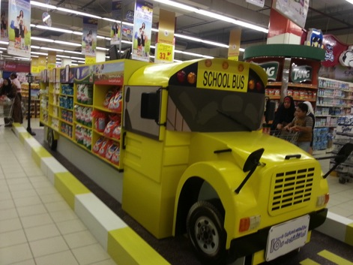
Hyper One Back to School Event- Display

Slide 26
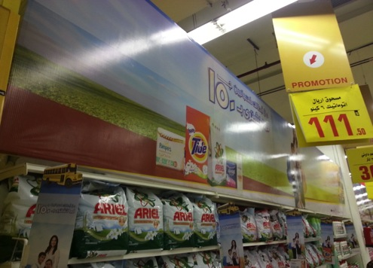
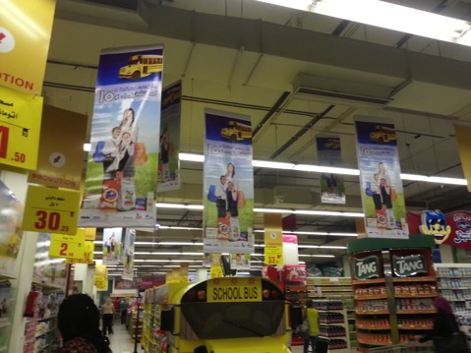
Hyper One Back to School Event- Display

Slide 27
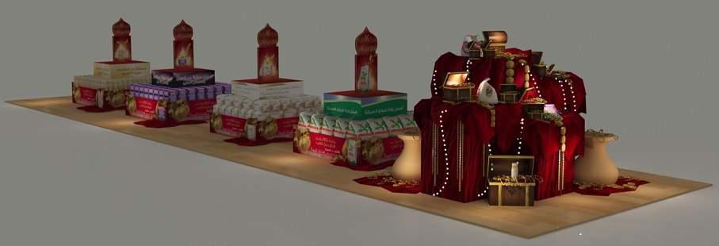
Hyper One Gold Event

Slide 28
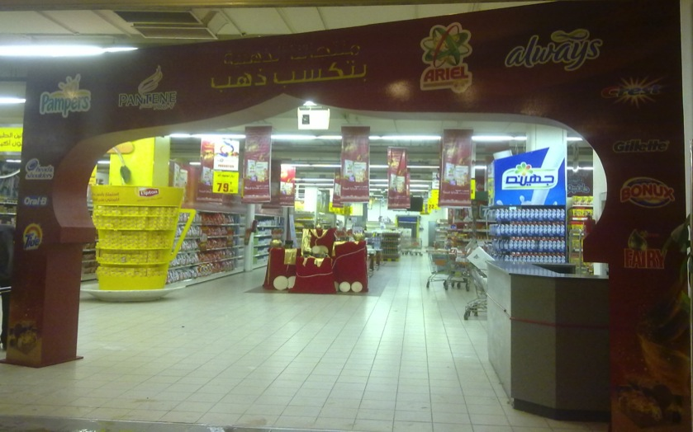
Hyper Gold Event -Gate

Slide 29
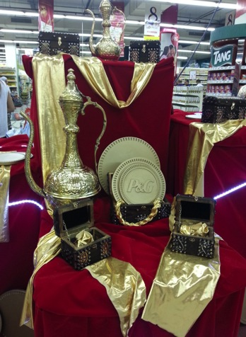
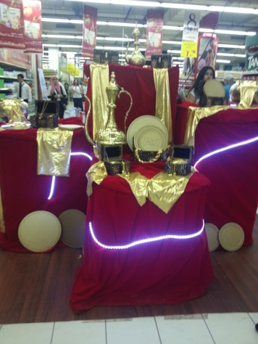
Hyper Gold Event-Display

Slide 30
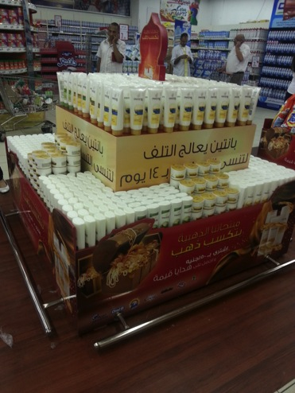
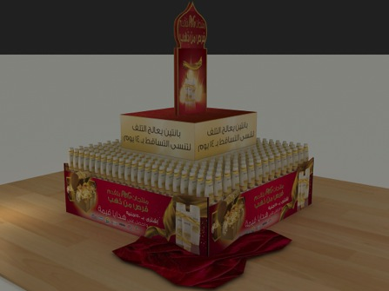
Hyper Gold Event -Display

Slide 31
Hyper Gold Event- Category Header

Slide 32
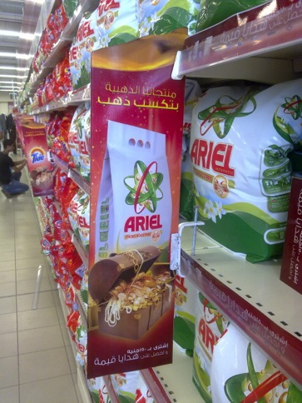
Hyper Gold Event
Actual
Design

Slide 33
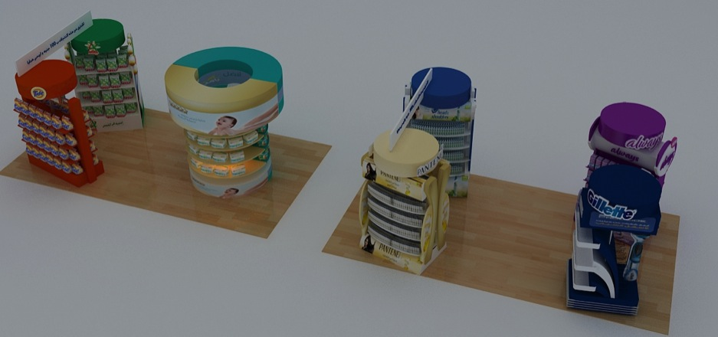
Hyper One Kasban Kasban Event- Design

Slide 34
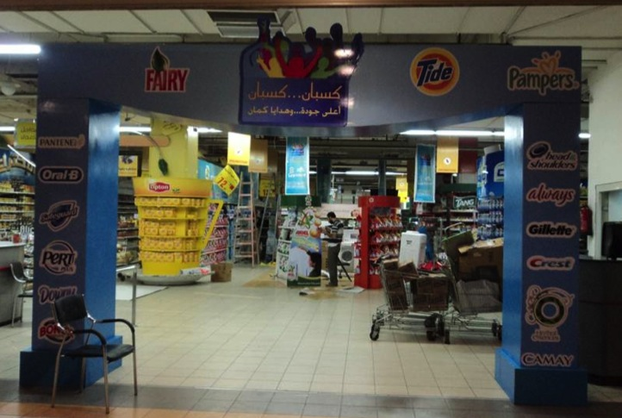
Hyper One Kasban Kasban Event- Gate

Slide 35
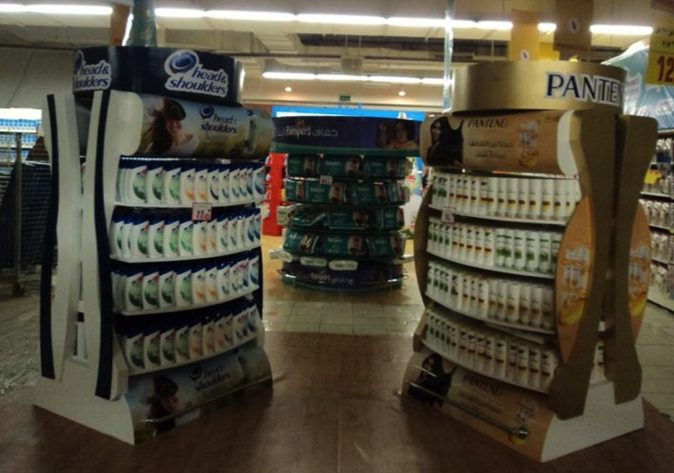
Hyper One Kasban Kasban Event- Stands

Slide 36
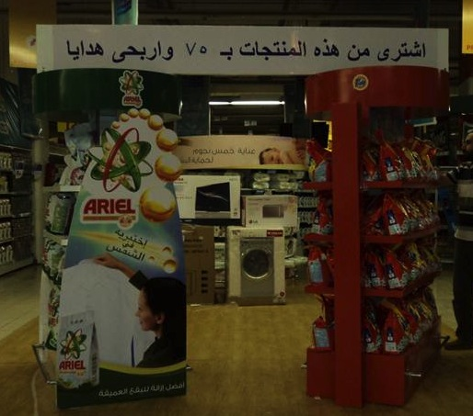
Hyper One Kasban Kasban Event- Stands

Slide 37
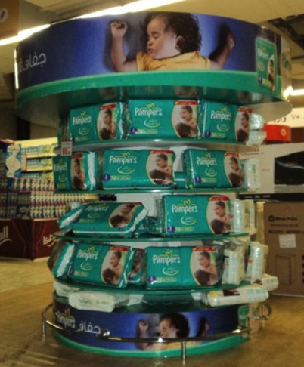
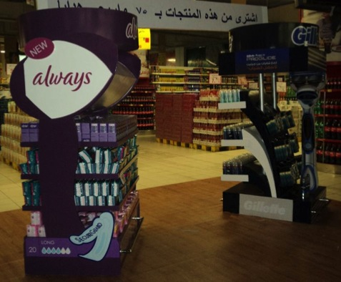
Hyper One Kasban Kasban Event- Stands

Slide 38
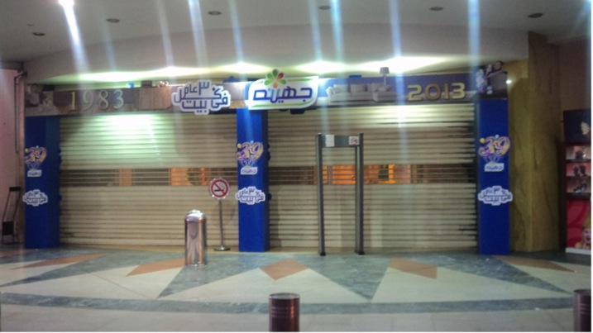
Juhayna 30 yrs event - Gate

Slide 39
Juhayna 30 yrs event - Displays

Slide 40
Outdoor -Events

Slide 41
Fine – Team Building Event

Slide 42
Danone 5 Y anniversary Event

Slide 43
Out Door Branding

Slide 44
Formula Out-Door Branding

Slide 45
Formula Out-Door Branding

Slide 46
Formula In-Door Branding

Slide 47
نادي الشمس
محطة مترو انفاق حلوان
امتداد رمسيس
ميدان الحجاز
جسر السويس-وجه 1
عباس العقاد
نفق الشيراتون (امام فندق بيراميزا)
شارع سوريا

Slide 49
Booths

Slide 50
UFI/Diva – HACE Exhibition - Design

Slide 51
UFI/Diva – HACE Exhibition - Production

Slide 52
City Scape Booth

Slide 54
Actual
Design

Slide 55
Actual
Design

Slide 57
Actual
Design

Slide 58
Retail Solutions
& Kiosks

Slide 59
Retail Solution

Slide 60
Retail Solution

Slide 61
Braun Shop in shop

Slide 62
Shop in shop

Slide 63
Kiosks

Slide 64
Kiosks

Slide 65
Stands & Comment box

Slide 66
Lighted Signs

Slide 67
Wall Branding

Slide 68
Displays

Slide 69
Actual
Design

Slide 70
Actual
Design

Slide 71
Actual
Design

Slide 72
Nido Photo Booth
Actual
Design

Slide 73
Actual
Design

Slide 74
Actual
Design

Slide 76
Display Units

Slide 77
Activation Booth

Slide 78
Mega Display

Slide 83
Different stands

Slide 84
Always stands

Slide 85
Nesquik stands

Slide 86
Chiller Carrier Stands

Slide 87
Head and Shoulders

Slide 89
Cashier stands

Slide 90
Metal Display

Slide 91
Stands

Slide 92
Metal Stand

Slide 93
Out Door Double face

Slide 95
Metal/Wood Stand

Slide 96
Category Header

Slide 97
Gondola

Slide 98
Pepsi Euro Cup campaign

Slide 99
Mountain Dew

Slide 100
Nestle Gondola’s

Slide 101
3D Gondola’s

Slide 102
Emirates Misr gondola Rebranding
Actual
Design

Slide 103
Emirates Misr gondola Rebranding
Actual
Design

Slide 104
Emirates Misr gondola Rebranding
Actual
Design

Slide 105
Emirates Misr gondola Rebranding
Actual
Design

Slide 106
Flutes Ramadan gondola

Slide 107
President Campaign

Slide 108
Parachute Gondola

Slide 110
Gates

Slide 111
Actual
Design

Slide 113
Bridge

Slide 114
OTC

Slide 115
Aclaryic OTC

Slide 116
Carton OTC

Slide 117
Wood OTC

Slide 118
OTC Stand

Slide 119
Truck Branding

Slide 121
Giveaways

Slide 122
Summer Giveaways

Slide 123
Ramadan Giveaways

Slide 124
Lanyards

Slide 125
Bags

Slide 126
Rope Bags

Slide 128
Waist Bags

Slide 129
Cooler bags

Slide 130
Bags

Slide 131
Laptop Bags

Slide 132
Pencil Case & Make up bags

Slide 133
Assorted giveaways

Slide 134
Caps and Scarfs

Slide 135
Uniform

Slide 136
KIT KAT Jacket

Slide 137
Towels And Apron

Slide 138
Premiums

Slide 139
Office giveaways

Slide 140
Key Chain

Slide 141
Office Gifts

Slide 146
Coasters

Slide 148
Sets

Slide 149
Customised Wall Clock

Slide 150
Customized wallets and pencil cases

Slide 151
Assorted Giveaways
Pen
Clip Board
Calculator

Slide 152
Printing

Slide 153
NoteBooks

Slide 154
Note Books

Slide 155
Note Books

Slide 156
Coloring Book

Slide 157
Pyramid Calendar

Slide 160
Hair Code Foam Mockup

Slide 164
Acrylic Signs

Slide 165
Palate Displays

Slide 168
Retail Concepts

Slide 169
3D Designs

Slide 173
3D Designs

Slide 174
3D Designs

Slide 175
3D Designs

Slide 176
3D Designs

Slide 178
3D Designs

Slide 179
3D Designs

Slide 180
3D Designs

Slide 181
3D Designs

Slide 185
3D Designs

Slide 200
Revolving Light Box

Slide 207
Wall Branding

Slide 209
Internal communication
Communication Initiatives
Employee Giveaways
In Office Activation
Internal
Events
Designing Services

Slide 210
People Survey
Employees are reluctant to contribute in People Surveys
Increase Response Rates
Increase Employee Engagement
Increase Engagement Index
We offer new innovative:
Concepts
Interactive activities
Games
Videos
PS: Some pictures were withheld due to client confidentiality agreement

Slide 211
Safety Projects
Promoting the idea of Safety among company employees
Creating excitement around an important cause
Communicate safety instructions in an interactive and engaging matter
Application options:
Video & Testimonials
Interactive Games & Contests
Banding
Giveaways & Trophies
Safety Kit
Safety solutions
Tool Kit
PS: Some pictures were withheld due to client confidentiality agreement

Slide 212
Change Management
Develop programs for change management
Minimizing resistance
Engaging employees
Increasing employees Buy-In
Application Options:
Welcome bundle
Change management seminars
Interactive applications
PS: Some pictures were withheld due to client confidentiality agreement

Slide 213
Diversity Projects
Creating a multicultural organization
Promoting the idea of diversity among the employees
Communicating the benefits of diversification
Providing different interactive concepts and applications
PS: Some pictures were withheld due to client confidentiality agreement

Slide 214
Building Trust
Enforcing positive habits amongst employees
Promoting ethical behavior in
an attractive and innovative ways
Enforcing a culture of trust inside
the company
PS: Some pictures were withheld due to client confidentiality agreement

Slide 215
Communicate Internal Communication Initiatives through:
Develop Concept Designs
Develop Applications
Designs Executions
PS: Some pictures were withheld due to client confidentiality agreement

Slide 219
Offering a designer dedicated to your Internal Communication designs including:
Company Newsletters
Certificates
Trophies
Employee Loyalty Cards
Desktops Wallpapers
Calendars
Theme based giveaways
PS: Some pictures were withheld due to client confidentiality agreement

Slide 220
Activation and Engagement activities
Increase employee Loyalty
Increase employee Buy-In
Nescafe Cappuccino Office Sampling – Etisalat Premises
Nescafe Cappuccino Office Sampling – Vodafone Premises
PS: Some pictures were withheld due to client confidentiality agreement

Slide 221
Internal Celebrations
Anniversaries
New Year Celebrations
Product Launch
PS: Some pictures were withheld due to client confidentiality agreement

Slide 222
Support HR in recruiting high caliber employees through:
Attracting potential employees
Build the company image for prospect employees
Application
Innovative booth designs
Innovative booklet ad designs
Innovative logos and concept designs
PS: Some pictures were withheld due to client confidentiality agreement

